Slide 1
ENERGY PREDICTOR
PREDICTING THE ENERGY CONSUMPTION OF A BUILDING
Group Members:
Atifa Sarwar
Raagini Rameshwar
Snehal Dikhale

Slide 2
Overview
Open Kaggle Competition - ASHRAE Great Energy Predictor III
Tall buildings for using ground space effectively
Expensive to regulate their temperatures
Improvements for energy consumption
No way to know how much energy a building would have used without these improvements
This project aims to predict how much energy a building with certain properties will consume under certain weather conditions without using improvements.
* Ongoing Kaggle Competition

Slide 3
Goals
Perform basic analysis on the given data
Build models using four different ML techniques
Compare the results to have an insights about different techniques

Slide 4
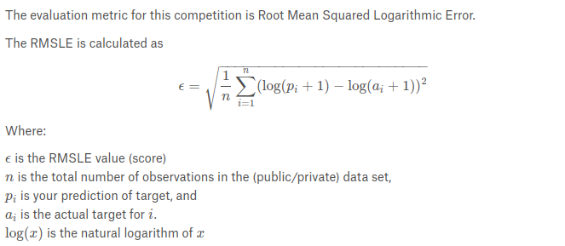
Evaluation Metric

Slide 5
Data
Kaggle Dataset
Energy Consumption of 1448 Buildings
Hourly meter readings over 3 years
Weather Conditions at multiple timestamps
Total of 20 million training rows
16 columns
Target is the Meter Reading (Regression Problem)
All numeric values except one
Life seems Easy ???

Slide 6
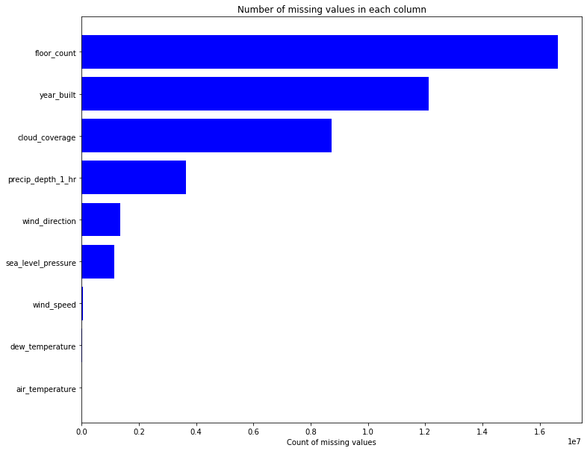
Data Analysis - Missing Values

Slide 7
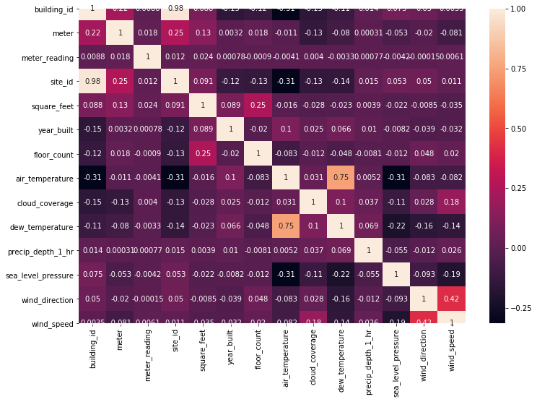
Correlations of Features

Slide 8
First Model Training
Trained a regressor model
Dropped some of the columns
Filled the rest with median values due to outliers
Error was completely unexpected.
Error:
2358945.21

Slide 9
Inconsistent Column Values
Column | Min | Max
Square Feet | 283 | 875k
Year Built | 1900 | 2017
precip_depth_1_hr | -1 | 343
dew_temperature | -26 | 35.1

Slide 10
Data Preprocessing
Missing values:
Mean over timestamp
Median due to outliers
Feature Normalization
Log on square_feet
Degree to 16 compass directions for wind direction
Wind Speed to beaufort scale (wind speed to observed conditions at land)
Timestamp to hour and week of day
One hot encoding

Slide 11
Approaches
Decision Tree Regressor
Random Forest
Gradient Boosting Decision Trees
Gradient Boosting Random Forest
Neural Networks

Slide 12
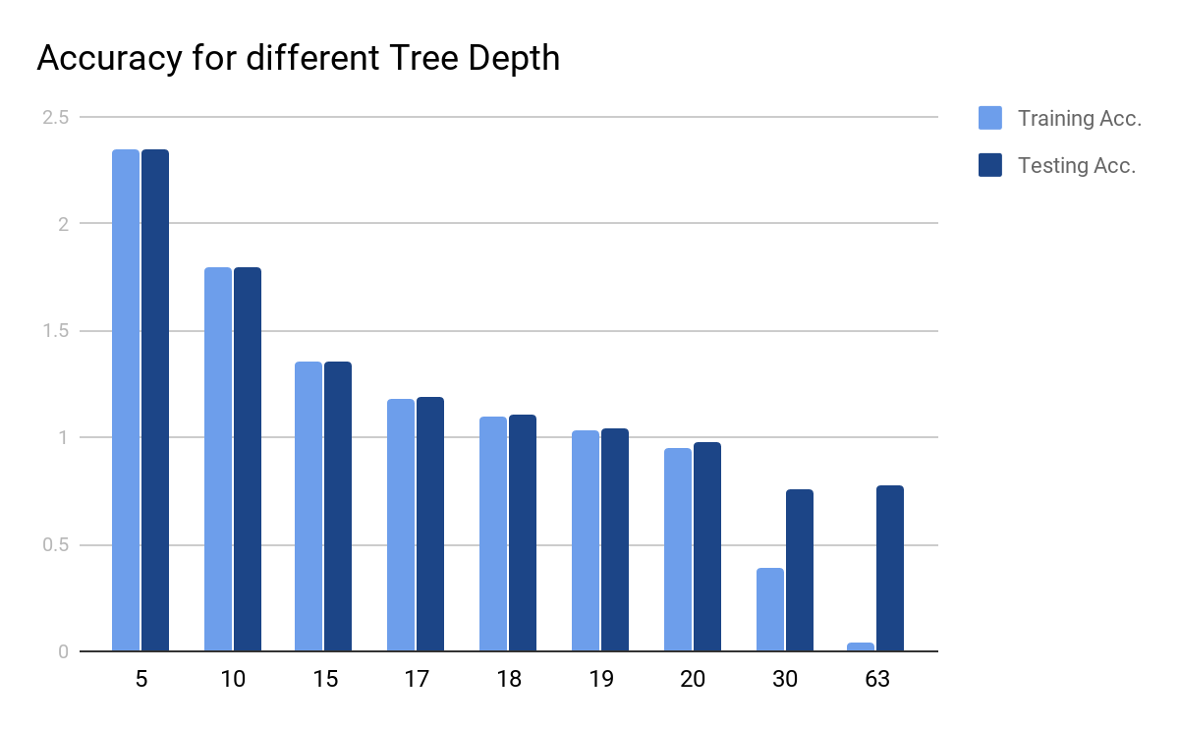
Decision Tree Regressor
OVERFITTING
Best Tree with depth 17
Kaggle score with Depth 17: 1.45
Kaggle score with Depth 20: 1.58

Slide 13
Random Forest
Depth | Trees | Training Accuracy | Testing Accuracy
18 | 100 | 1.28 | 1.30
18 | 300 | 1.28 | 1.30
30 | 100 | 0.96 | 0.98
30 | 300 | ?? | ??
Unable to train a forest with 300 trees with depth 30.
Google Colab RAM Expires
Even Google Cloud VM with 60GB of RAM Crashes

Slide 14
Light Gradient Boosting Methods
Light GBM is a gradient boosting framework that uses tree-based learning algorithms
Grows a tree vertically rather than horizontally
i.e. grows tree leaf-wise rather than level-wise.
Chooses the leaf with max delta loss and then grows that leaf
Benefits:
Can handle large size of data
Data size is increasing day by day
Focuses on accuray
Supports GPU Learning

Slide 15
Light Gradient Boosting Methods
 | Decision Tree | Random Forest
Objective | Regression | Regression
Regularization | L2 | L2
Boosting | GBDT | RF
Fraction | 0.85 | 0.9
Boosting Iterations | 100 | 1000
Training Accuracy | 0.79 | 0.915
Testing Accuracy | 1.08 | 1.18
Kaggle Score | 1 | 1.1

Slide 16
Neural Networks
 | Network I | Network II | Network III
Layers | 4 Fully Connected | 3 Fully Connected | 4 Fully Connected
Neurons | 128,64,32,16 | 64,32,16 | 128,64,32,16
Batch Normalization | No | Yes | Yes
Dropouts | No | Yes | Yes
Epochs | 5000 | 5000 | 5000
Error | 2.0 | 1.5 | 1.45

Slide 17
Takeaways
Project is more oriented towards features extraction and analysis.
Machine Learning is never only about choosing a good model.
Features are also an integral part of it.
Sometimes columns that seem useful e.g. floor count do not impact accuracy.
One of the recent submissions converts numerical attributes to categorical and use embeddings. Still the overall score is 1.1.
We found gradient boosting method best with small training time and accuracy of 1.00.

Slide 18
Thank You

Slide 19
References
Guolin Ke, Qi Meng, Thomas Finley, Taifeng Wang, Wei Chen, Weidong Ma, Qiwei Ye, Tie-Yan Liu. “LightGBM: A Highly Efficient Gradient Boosting Decision Tree.” Advances in Neural Information Processing Systems 30 (NIPS 2017), pp. 3149-3157
https://medium.com/@pushkarmandot/https-medium-com-pushkarmandot-what-is-lightgbm-how-to-implement-it-how-to-fine-tune-the-parameters-60347819b7fc
https://www.kaggle.com/c/ashrae-energy-prediction/overview

